Slide 1
Characterization
Populating your fictional world with believable people

Slide 2

Goal: create a character with…
Basic identifiable features (name, groups, etc)
A secret that provides depth and could fuel conflict
Unique physical features which make them authentic and can play a role in their development, conflict, etc
A “inventory” of character movements and physical objects which reveals the unspoken depth of their character
A “spine” or “motor” which drives all of their decision-making, thus making their actions natural and, at times, surprising
The level of complexity and contradiction which we experience with real people

Slide 3
Rules of the Workshop
Run with it.
  Be willing to experiment, push your boundaries, go overboard, not hold back
  Don’t be afraid to make a decision. If it turns out poorly, you can always turn back. And if it turns out great, with surprises and depth and truth, well…
Share with others.
  Break the isolation of being a writer—community builds confidence
  Creative Writing is not a competition
  No one has the right answer

Slide 4
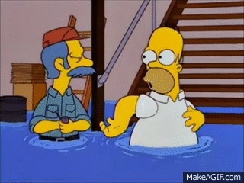

Slide 5
Where do Characters Come From? Discuss
“Characters pre-exist. They are found [through the act of writing]. They reveal themselves slowly [to the writer].”
-Elizabeth Bowen, “Notes on Writing a Novel”
“I always start with the main character or, as it may be, characters. Usually there are a number of people who have been inhabiting my head for a number of years before I begin on a novel, and their dilemmas grow out of what they are, where they come from”
-Margaret Laurence, in Eleven Canadian Novelists

Slide 6
Dynamic and Static Characters
Dynamic Character: changed or moved by the action in the story
  Usually, though not always, the main character of a story is dynamic
  Most critics and editors believe that this movement is necessary to all effective story structure
Static Character: unchanged or unmoved by the action in the story
  If your main character is static, then the reader must be moved or changed by the action

Slide 7
Flat or Round Characters
Flat: superficial or two-dimensional characters
  Often take the shape of recognizable stereotype—the hero, the villain, the handsome lover, etc
Round: have deeper qualities; consistent inconsistencies that make them more complex and individual

Slide 8
Round
Some Supporting Characters
Protagonists
Antagonists
Some Supporting Characters
Background Characters
Some Supporting Characters
Static
Dynamic
Flat

Slide 9
Authenticity
Agenda
Complexity
Essential elements of your main character(s)

Slide 10
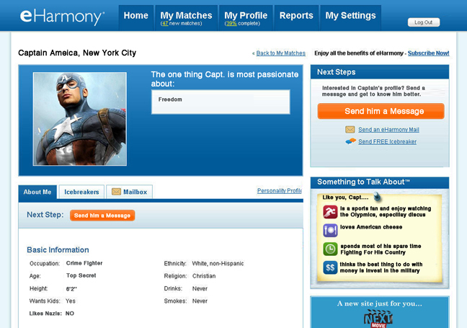
Building Authenticity: Identifying Info
  Name
  Gender
  Age
  Race/Nationality
  Social class
  Region/Country of Origin
  Time Period
  Profession
  Marital status
  etc

Slide 11
Authenticity
“The writer’s characters must stand before us with…such continuous clarity that nothing they do strikes us as improbable behavior for just that character, even when the character’s action is…something that came as a surprise to the writer himself.
We must understand, and the writer before us must understand, more than we know about the character; otherwise, neither the writer nor the reader after him could feel confident of the character’s behavior when the character acts freely.” (John Gardner, The Art of Fiction)

Slide 12
Building Authenticity: Defy Stereotypes
  Advice from an actress to a male writer: “Write a character named Dick. When you finish, change the name to Wilma and adjust all of the pronouns.”
    Basically, she was saying women aren’t any less complex and dimensional than men. (The Portable MFA in Creative Writing)
    Don’t limit the potential of a character, her motivation and goals, his potential, etc. based on gender, race, socio-economics, country of origin, sexuality, etc.
  “Should the pimp drive a Cadillac? He can of course. But I’m going to name my pimp Orville and put him in a Yugo.” (Ron Carlson Writes a Story)

Slide 13
Building Authenticity: Names
Do names matter?
  Yes and no
Names should feel natural
  Unusual names—Katniss, Peta, Tris, Four, Ender, Petra, etc—all need to be earned
  They shouldn’t interrupt the “narrative dream”
If your character is based on a real person, change the name
  By shedding the name, the character can move beyond the person she is based on

Slide 14

Let’s Build a Character!
(Characterization Exercise A)
  Name (First and Last)
  Gender
  Age
  Race/Nationality
  Social class
  Region/Country of Origin
  Time Period
  Profession
  Marital status
  SECRET

Slide 15
Showing Us the Character versus
Telling Us about the Character
Stated by the Author/Narrator
Mr. Maurice Smith was something of a snob.
Stated by the Character Him/Herself
I am much more discerning than I used to be, Smith thought. Though I suppose I’ve become a bit of a snob in the process.
Stated by Another Character
“Don’t waste your time on him,” Jane Roberts said to her younger sister. “Maury Smith has no time for the likes of us anymore.”
Suggested by the Character’s Actions
When Maurice Smith turned the corner, he discovered the source of the shouting. A demonstration. Laborers in hard hats wielded placards. One of the men pushed a pamphlet into Smith’s hands. He dropped it as he might have dropped a handful of steaming dung, and hurried away, glancing to either side in case someone he knew had seen him in such filthy company.
Notes:
Taken from A Passion for Narrative by Jack Hodgins

Slide 16
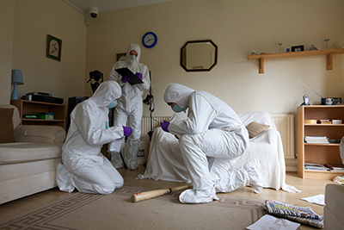
Showing Character through Inventory
Inventory (as defined by Ron Carlson): the physical details of the character as well as the unique objects/possessions which help define him/her

Slide 17
Characterization Exercise B
Describe a possession which your character values. Where do they keep it? How do they handle it? What is its condition and how do they preserve it? How did they get it? Is it connected to someone or an event from the past?
What have you learned about your character through this piece of inventory?

Slide 18
Inventory: Appearance
Features, shape, style, clothing, and objects can make a statement about internal values.
My grandmother had on not just one skirt, but four, one over the other. It should not be supposed that she wore one skirt and three petticoats; no, she wore four skirts; one supported the next, and she wore the lot of them in accordance with a definite system, that is, the order of the skirts was changed from day to day…The one that was closest to her yesterday clearly disclosed the pattern today, or rather its lack of pattern: all my grandmother Anna Bronski’s skirts favored the same potato color. It must have been becoming to her.
Gunter Grass, The Tin Drum

Slide 19
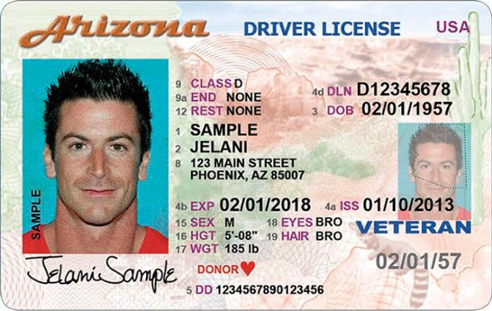
Inventory: Appearance
“On the body—part is better than the whole. Don’t be encyclopedic from head to toe. Use the cowlick or the brown tooth or one single thing that we can believe and hold onto…The body may be important to your story, and you may want to shine a light on a facet of it so that the reader can better imagine and thereby follow the character, but don’t stop the story to do it. The attributes you give the body should play a part in the story and not feel like furniture we need to lug around…what we want is to have physical details that are simply believable at first and convincingly brought forward or visited again.” –Ron Carlson
Focus on relevant, unique, and telling details.

Slide 20
Characterization Exercise C
Your character meets someone for the first time.
  Which physical features does that person notice within the first minute of meeting him/her?
  Which features is he/she proud of?
  Which features does he/she try to hide?

Slide 21
Agenda
“No fiction can have real interest if the central character is not an agent of struggling for his or her own goals but a victim subject to the will of others. (Failure to recognize that the central character must act, not simply be acted upon, is the single most common mistake in the fiction of beginners.) We care how things turn out because the character cares—our interest comes from empathy—and though we may know more than the character knows, anticipate dangers the character cannot see, we understand and to some degree sympathize with the character’s desire, approving what the character approves (what the character values), even if we sense that the character’s ideas is impractical or insufficient” (John Gardner, The Art of Fiction)

Slide 22
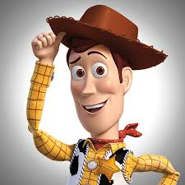
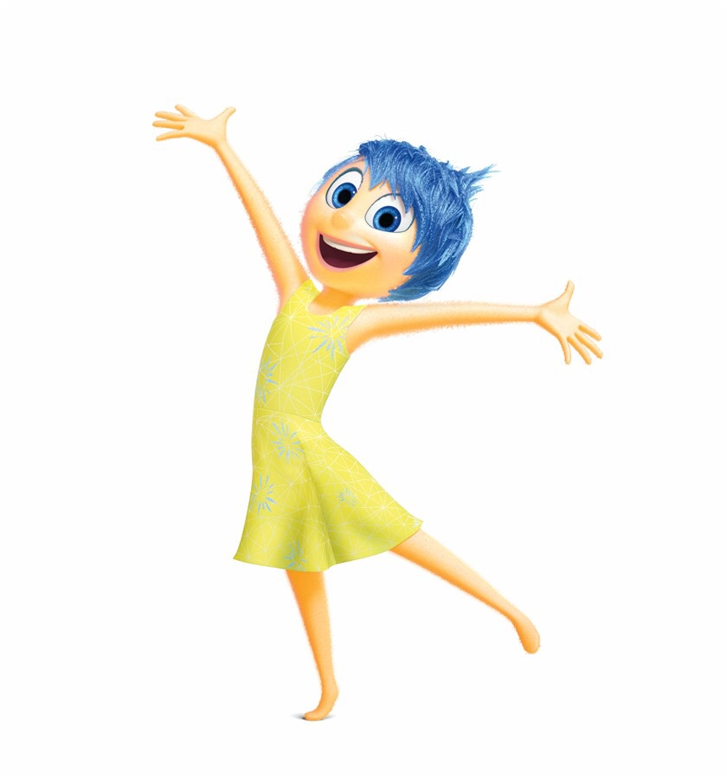

Agenda: The Character’s “Spine”
Judith Weston (via Andrew Stanton):
“[A]ll well-drawn characters have a spine. And the idea is that the character has an inner motor, a dominant, unconscious goal that they're striving for, an itch that they can't scratch…And these spines don't always drive you to make the best choices. Sometimes you can make some horrible choices with them.”

Slide 23
Hey, Remember Me?
Characterization Exercise D
Answer AT LEAST 2 of the following questions about your character to help discover agenda
  What would they do if they weren’t so afraid?
  Whom do they want to make proud?
  What would they like to forget?
  What would they rather be doing when they’re at work?
  What is on their bucket list?
  Who would they like to remove from their life?
  Where would they start a new life?

Slide 24
Movement and Action
Movement helps define a character for the reader
  Most effective way to demonstrate character, although it is not the most economical
  It interests while it informs and the image remains fresh in the reader’s mind.
  The reader arrives at her own interpretation of the character; thus the experience is more satisfying
Ex. When the beer came, I dipped a finger in it and wet down each corner of the paper napkin to anchor it, so it would not come up with the mug each time and make me appear ridiculous. I drank from the side of the mug that a left-handed person would use, in belief that fewer mouths had been on that side. From Dog of the South
Notes:
Adapted from Writing Fiction by Janet Burroway

Slide 25
Movement and Action
Action marks an internal or mental moment of change within a character.
  Characters cause action and are changed by action
The unknown becomes known, and then the discoverer must either take action or deliberately not take action: either choice reveals something about the character
Action must be natural to the character—that is, action must be plausible to what we know about the character.

Slide 26
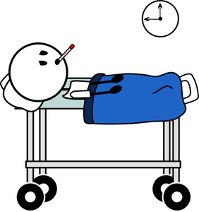
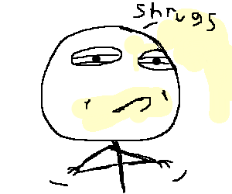
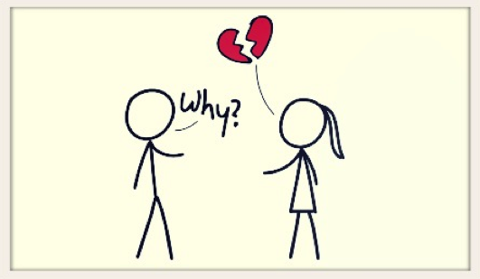



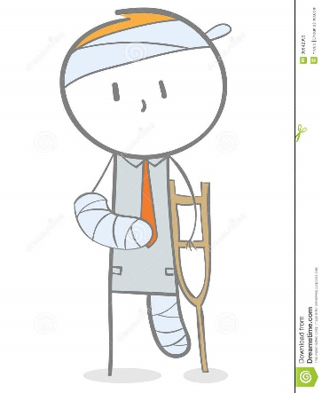
Movement and Action

Slide 27
Movement and Action (Characterization Exercise E)
Movement (Choose 1)
Action (Choose 1)
Describe how your character:
Walks
Sleeps
Eats
Drives
Describe how your character would react to:
Being challenged to a fist fight
Finding a suitcase full of cash
Speaking in front of a large group of people
Being cut off in traffic
Being cut off in conversation
Running into an old lover
A funeral

Slide 28
Complexity
“[Characters] need to exhibit enough conflict and contradiction that we can recognize them as belonging to the human race; and they should exhibit a range of possibility so that the shift in power in the plot can also produce a shift in purpose or morality. That is, they need to be capable of change” (Janet Burroway, Writing Fiction).
“The literary story is a story that deals with the complicated human heart with an honest tolerance for the ambiguity in which we live. No good guys, no bad guys, just guys, that is, people bearing up in the crucible of their days and certainly not always—if ever—capable of articulating their position” (Ron Carlson Writes a Story)

Slide 29

Consider Polarities
Elegant/Vulgar
Stingy/Generous
Extrovert/Introvert
Cheerful/Morose
Brilliant/Stupid
Public/Private
Etc.

Slide 30
Consider Multiple Roles/Identities
Character A
Character B
Mother
Lawyer
Lover
Daughter
Volunteer
Cheater
Grandfather
Financial Advisor
Widower
Brother
Gardner
Drunkard

Slide 31
Write Sympathetically about ALL Characters
Give Heroes or Heroines a Flaw
  Tobias Wolff: mileage can be gained by creating a narrator or protagonist who has done something wrong
  That doesn’t make them the villain or evil; it makes them human
Give Villains Some Positive Quality
  Anton Chekhov: petting-the-dog moment
  Humanizing villain raises the stakes within the conflict and reminds reader of his/her humanity

Slide 32
Writing Exercise: Who Am I?
(Characterization Exercise F)
List your character’s name across the top of a sheet of paper and write “I am…” ten times. Turn each “I am” into a sentence describing the character.
  I am a girl with short brown hair.
  I am looking forward to the day I don’t live with my mother.
  I am going to be famous someday, etc…
Once you have established a character’s most prominent traits, round him/her out. Make another list, but this time use the “I ams” to explore the hidden side.
  I am blonde, but I wish I had black hair.
  I am afraid to live on my own.
  I am not good at anything; in fact, I am average, etc…

Slide 33
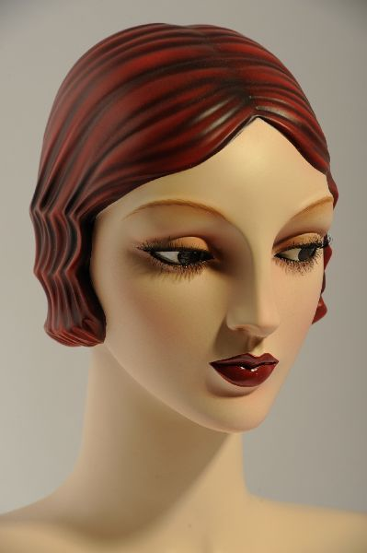

What have you made?
A character with
Basic identifiable features (name, groups, etc)
A secret that provides depth and could fuel conflict
Unique physical features which make them authentic and can play a role in their development, conflict, etc
A “inventory” of character movements and physical objects which reveals the unspoken depth of their character
A “spine” or “motor” which drives all of their decision-making, thus making their actions natural and, at times, surprising
The level of complexity and contradiction which we experience with real people

